Slide 1
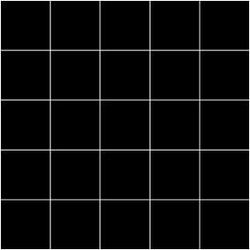


Open Minds Club
AI School Iteration 2.6
Random Forests, Naive Bayes and SVM
By BOULGHERAIF Fatma Zohra
<h4>
</h4>

Slide 2

Open Minds Club
Random Forests

Slide 3
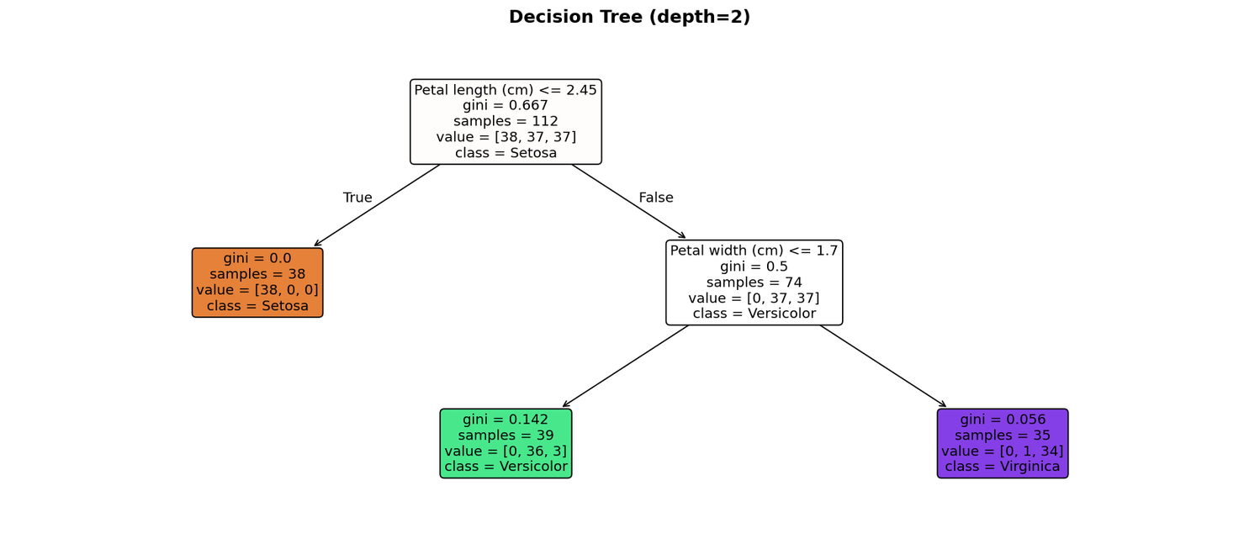
Open Minds Club
01. Decision Tree Recap
A Decision Tree learns a hierarchy of binary rules on the features.
- Each internal node = a split condition: feature ≤ threshold?
- Each leaf = a class prediction

Slide 4
Open Minds Club
02. The Problem with a Single Tree
Decision Trees are unstable
> Change a few training points → completely different tree.
 | Single Decision Tree
Accuracy | Good
Interpretability | High
Stability | Low (small data changes → big boundary changes)

Slide 5
Open Minds Club
The question: Can we keep the accuracy but reduce the instability?
→ Yes. Train many trees and let them vote.
THIS IS ENSEMBLE LEARNING.
Metrics

Slide 6
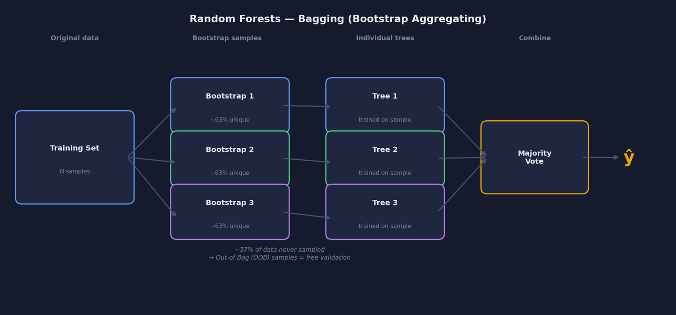
Open Minds Club
03. Bagging
Step 1: Give each tree different training data

Slide 7
Open Minds Club
03. Bagging
Step 1: Give each tree different training data
- For each tree, draw a random sample with replacement from the training set
- Each sample is roughly the same size, but some points appear twice, others not at all
- ~37% of points are left out of each sample → called Out-of-Bag (OOB) samples, free validation, no separate val set needed
Key idea: different data → different trees → genuine diversity

Slide 8
Open Minds Club
04. Feature Randomness
Step 2: Each split considers only a random subset of features
At every split, each tree only considers a random subset of features (default: √d).
Stops all trees from always splitting on the same feature → trees are less correlated → averaging works better.
Bagging + feature randomness = a forest of genuinely different trees

Slide 9
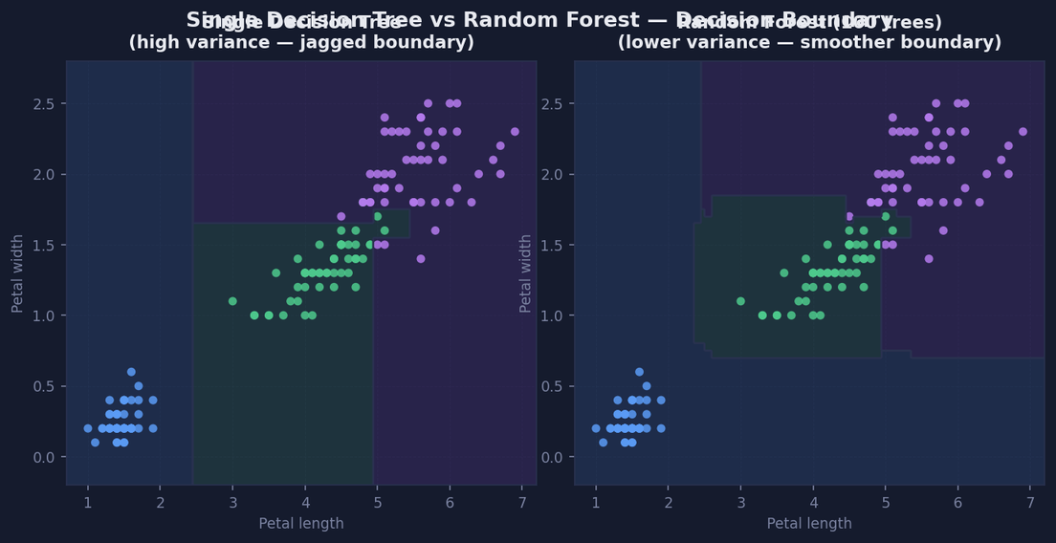
Open Minds Club
05. Why Averaging Works
One tree makes errors. 100 trees rarely all make the same error in the same place.
=> Averaging reduces mistakes

Slide 10
Open Minds Club
06. Random Forest in Practice
from sklearn.ensemble import RandomForestClassifier
rf = RandomForestClassifier(n_estimators=100, max_features='sqrt',
random_state=42)
rf.fit(X_tr, y_tr)
print(rf.feature_importances_) # averaged → stable
Scaling not required.

Slide 11
Open Minds Club
Naive Bayes

Slide 12
Open Minds Club
07. Two Approaches to Classification
Discriminative | Generative
Discriminative classifiers learn the boundary between classes (P(y|x)), focusing on direct mapping for classification | generative classifiers learn the underlying distribution of each class (P(x,y) or P(x|y) understand how data is generated
Logistic Regression | Naive Bayes

Slide 13
Open Minds Club
08. Bayes' Theorem
P(class | feature) ∝ P(feature | class) × P(class)
P(class | feature): What we want, the class probability
P(feature | class): How likely is this data in that class?
P(class): How common is this class overall?
Pick the class with the highest product. No training loop needed.

Slide 14
Open Minds Club
09. The Naive Assumption
Each feature is independent of the others, given the class.
Almost never true in practice, yet NB often works well. Even when individual probabilities are off, the ranking of classes is frequently correct.

Slide 15
Open Minds Club
SUPPORT VECTOR MACHINES
(SVM)

Slide 16
Open Minds Club
  The Problem: Too Many Valid Boundaries
> For any linearly separable dataset, infinitely many lines separate the classes.
> Logistic regression picks one. Which one is actually best?
Which boundary is best? → SVM's answer: the one that is as far as possible from both classes.

Slide 17
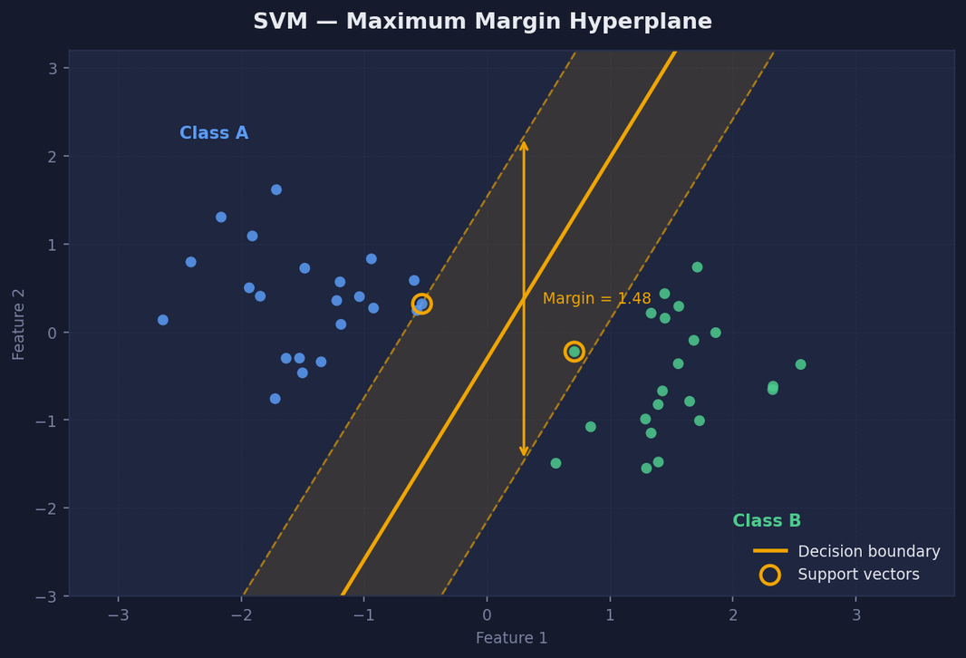
Open Minds Club
  The Maximum Margin
circled points = support vectors, the only ones that define the boundary

Slide 18
Open Minds Club
  Support Vectors
The boundary is defined by just a few points sitting on the margin edge.
  All other training points are irrelevant, removing them doesn't change the model
  Once trained, only support vectors need to be stored
  Compared to: KNN uses all training points at prediction time

Slide 19
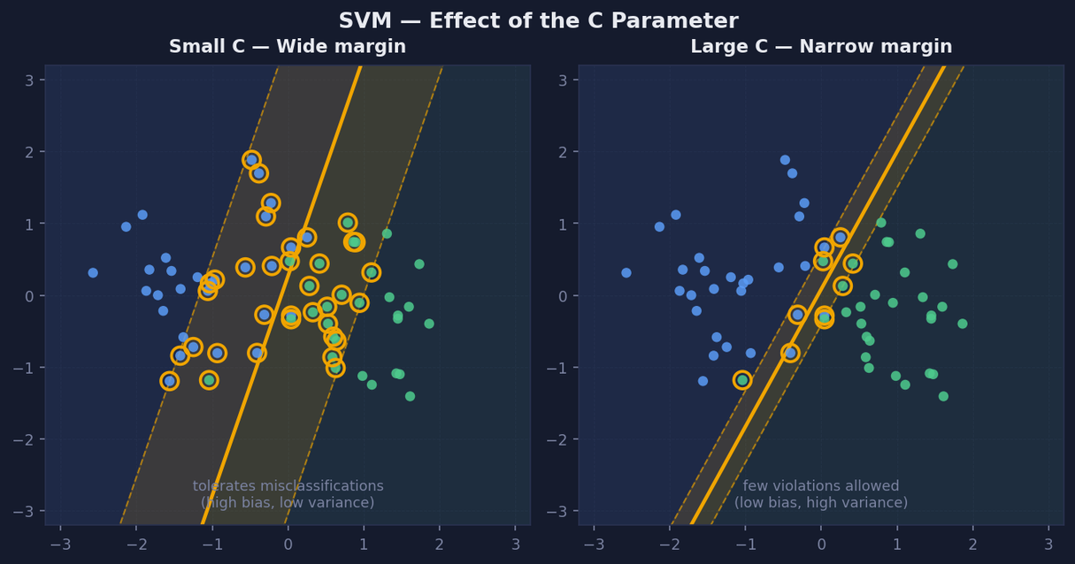
Open Minds Club
  The C Parameter
Tolerates misclassifications vs. Tighter fit to training data

Slide 20
Open Minds Club
Wrap Up

Slide 21
Open Minds Club
All Five Models
Model | Scaling | Interpretable | Speed
KNN | Yes | No | Slow at inference
Decision Tree | No | Yes | Fast
Random Forest | No | Partial | Moderate
Naive Bayes | No | Partial | Very fast
SVM | Yes | No | Slow for large n

Slide 22
Open Minds Club
Model Family Tree
Classification models
├── Instance-based → KNN
├── Rule-based → Decision Tree, Random Forest
├── Probabilistic → Naive Bayes
└── Margin-based → SVM

Slide 23

Open Minds Club
Any Questions ?

Slide 24
Open Minds Club
Thank you for your attention ✨

